Slide 1

Wiki Gaming
Week 3
The Larger Group
Intro
1
Catalog
2 3
User Forms
4
Accounts
5
Voting
6
Marketing
7
Overall
8

Slide 2
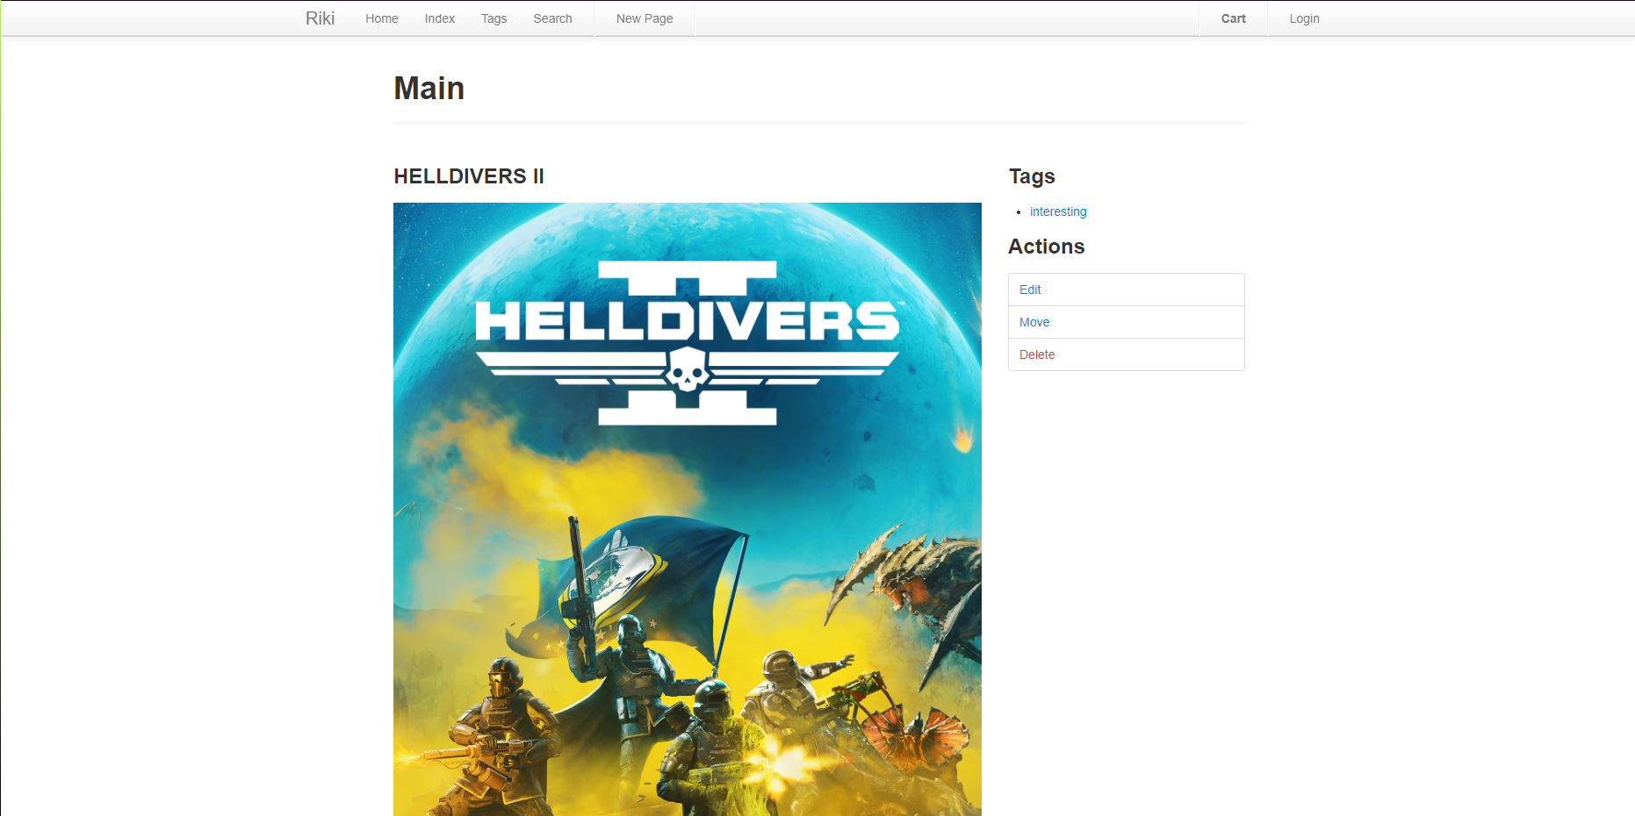
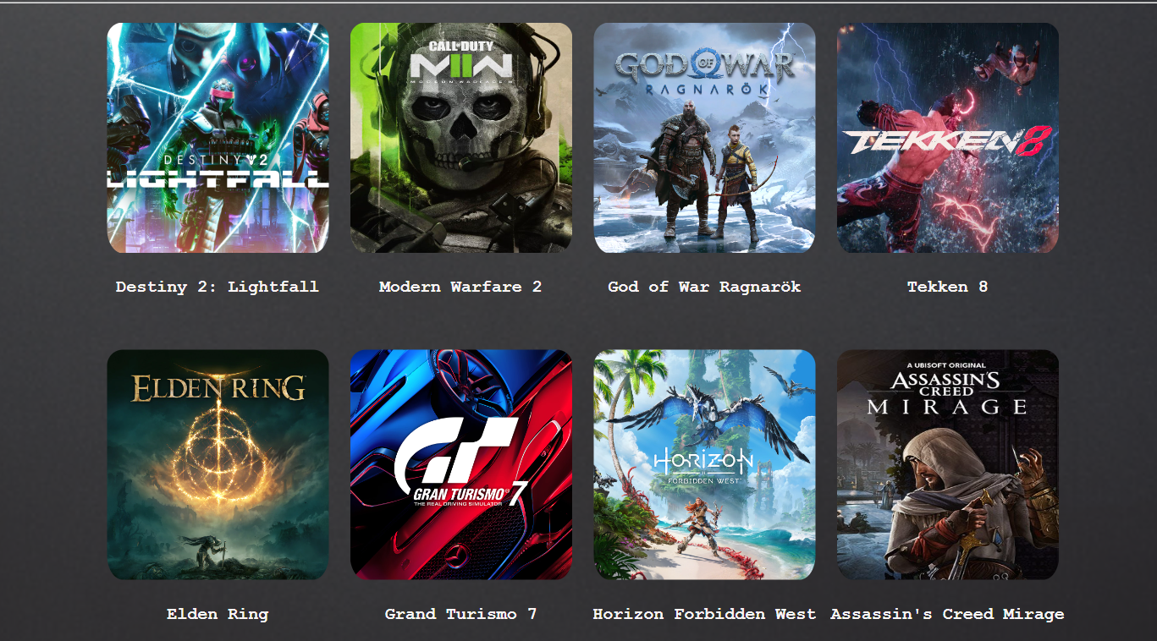
The Catalog
Requirement
As a User, I want to see a Game Catalog, so I can browse what games are out.
Lines of Code: 0
Tests: 0/24
Burndown: 15%
Intro
1
Catalog
2 3
User Forms
4
Accounts
5
Voting
6
Marketing
7
Overall
8

Slide 3
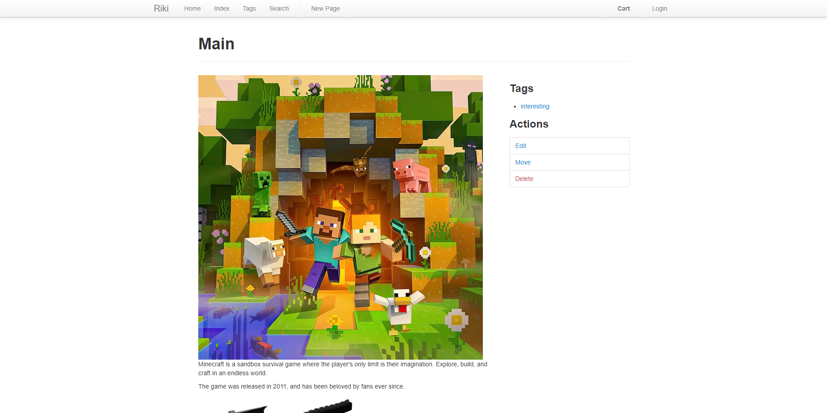
Individual Games
Requirement
As a User, I want to be able to see Game Forms, so that I can know what these games are about.
Lines of Code: 0
Tests: 0/12
Burndown: 10%
Intro
1
Catalog
2 3
User Forms
4
Accounts
5
Voting
6
Marketing
7
Overall
8

Slide 4
User Forms
Requirements
As a User, I want to be able to speak to others, so that I can know what others think about these games.
Lines of Code: 28
Tests: 0/12
Burndown: 20%
Intro
1
Catalog
2 3
User Forms
4
Accounts
5
Voting
6
Marketing
7
Overall
8

Slide 5
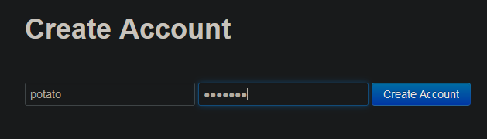
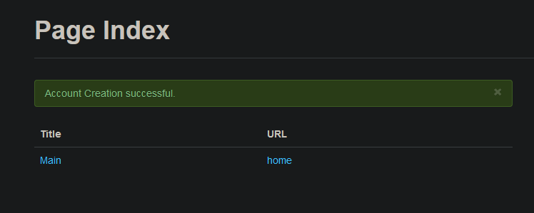
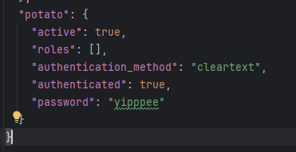
User Accounts
Requirements
As a User, I want a User Profile, so that I can know what I have said and save what I am interested in.
Lines of Code: 38
Tests: 0/15
Burndown: 20%
Intro
1
Catalog
2 3
User Forms
4
Accounts
5
Voting
6
Marketing
7
Overall
8

Slide 6
Community Voting
Requirements
As a User, I want to vote on games and comments, so that I can say what I enjoy and see what others also enjoy.
Lines of Code: 0
Tests: 0/24
Burndown: 20%
Intro
1
Catalog
2 3
User Forms
4
Accounts
5
Voting
6
Marketing
7
Overall
8

Slide 7
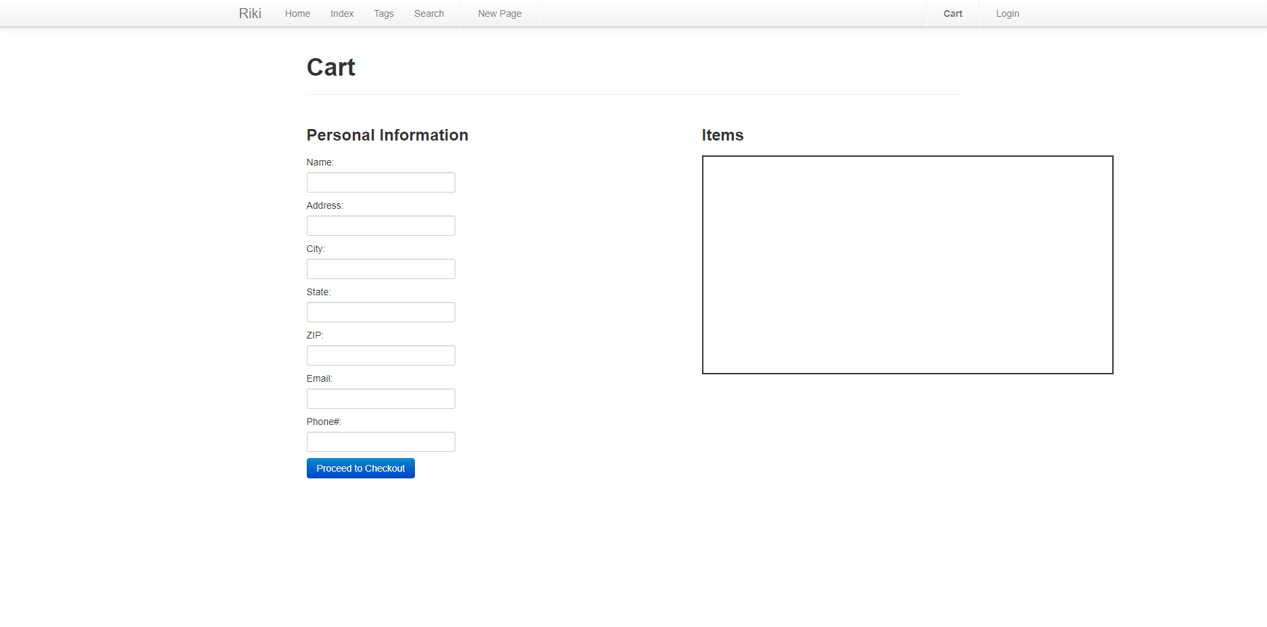
Marketing
Requirements
As a User, I want a market system, so that I can quickly buy games that I find interesting.
Lines of Code: 65
Tests: 0/12
Burndown: 45%
Intro
1
Catalog
2 3
User Forms
4
Accounts
5
Voting
6
Marketing
7
Overall
8

Slide 8
Overall
Lines of Code: 131
Tests: 0/99
Burndown: 20%
Milestone 3
Date: 4/7/2024
Goal: Start the implementation of features together.
Risks
Upcoming exam and homework
Intro
1
Catalog
2 3
User Forms
4
Accounts
5
Voting
6
Marketing
7
Overall
8

